Slide 1


Static sites, Dynamic Microservices, & Azure: How We Built Microsoft Docs and Learn
Dan Fernandez
Principal Group Program Manager, azure.microsoft.com
@docsmsft
@danielfe

Slide 2
Agenda
Why Docs
Architecture
GitHub
Learn
A New Hope
How Docs Works
API Reference
Resources

Slide 3
Why?

Slide 4
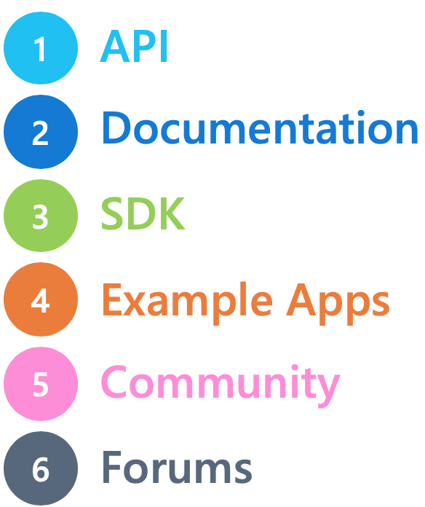
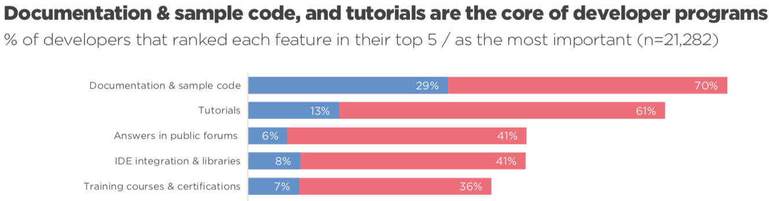
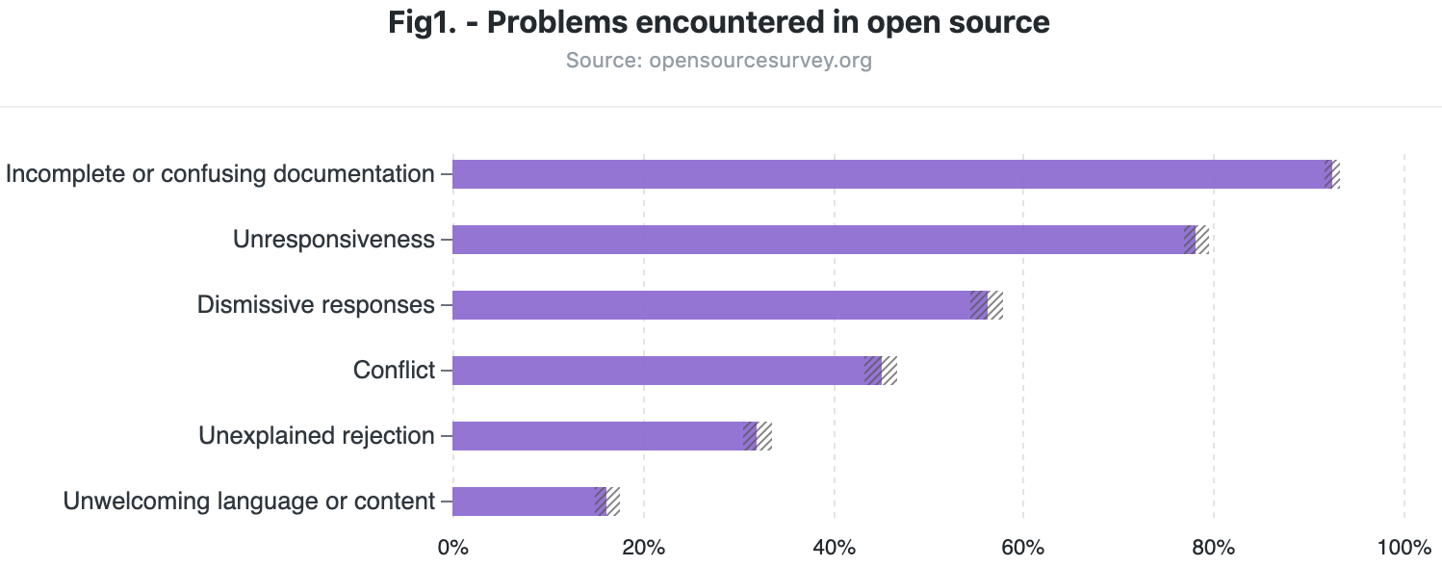

Developer Importance
SlashData Developer Benchmark 2017
DZone Dev Survey
“While Microsoft Azure is an enterprise-ready platform … customers cite issues with documentation and training…”
GitHub: https://opensourcesurvey.org/2017/
Gartner Magic Quadrant 2016

Slide 5
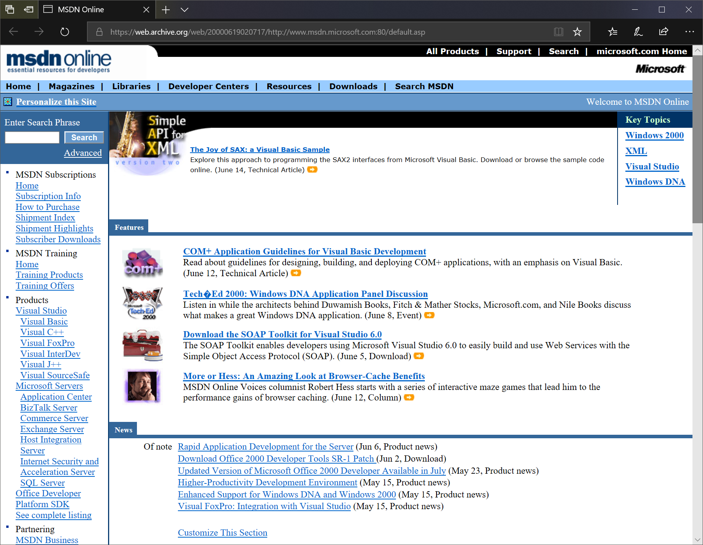
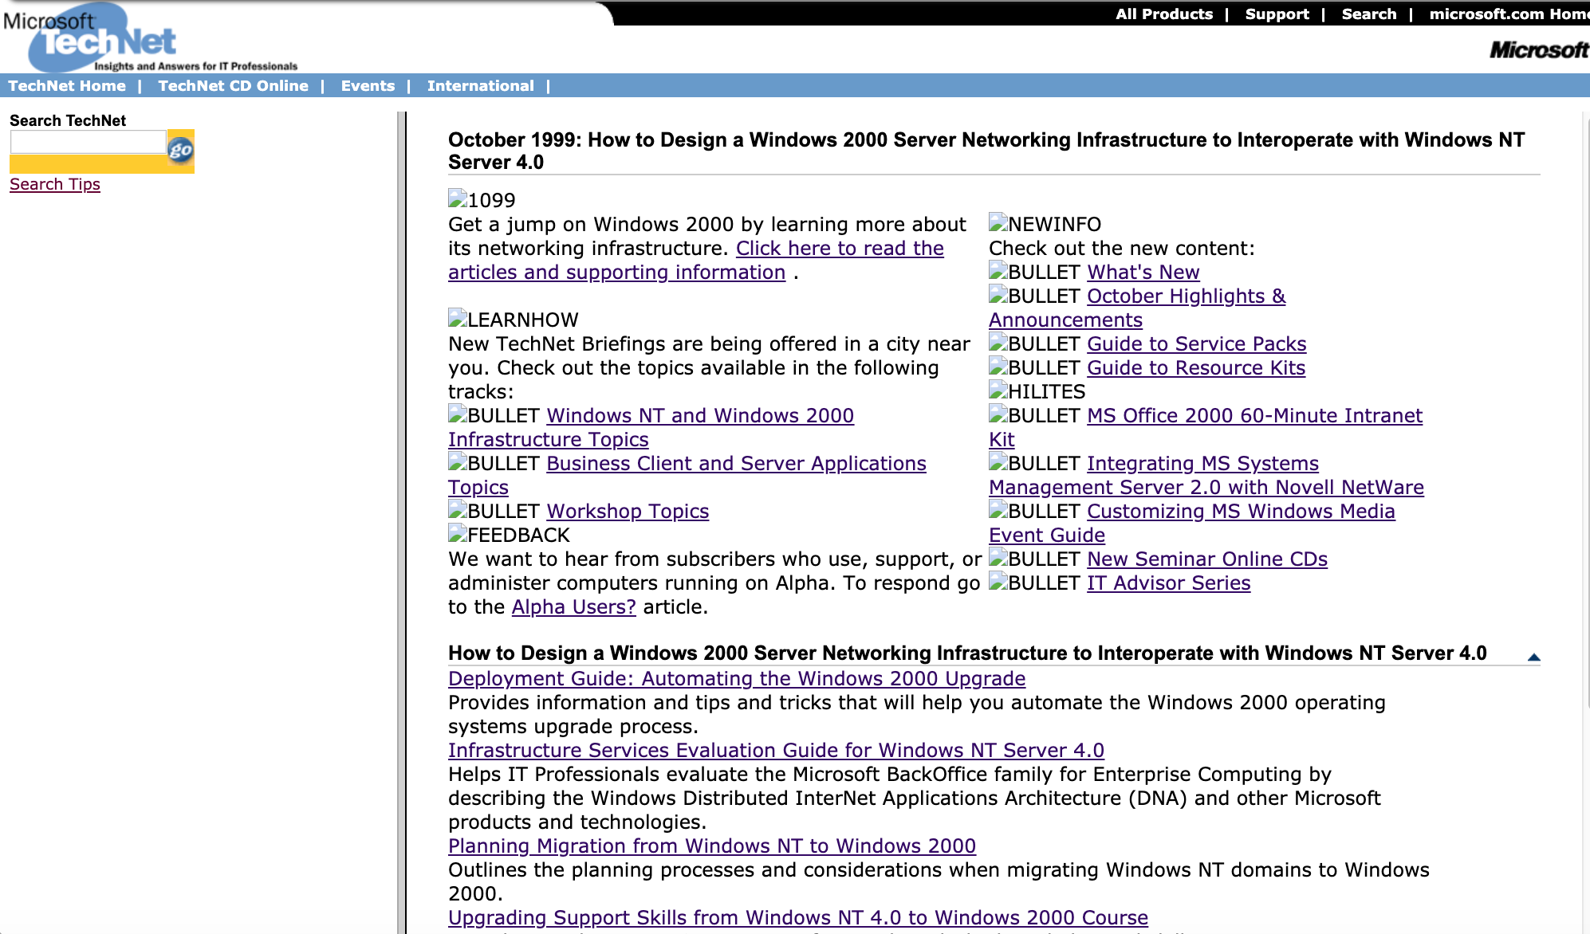
MSDN and TechNet
Publishing technical documentation when MSDN was launched in 1992 (on CDs)
Doc writers only
Little to no automation
Proprietary formats
Architecture: On-Premises and costly
Can’t keep up
.NET Core
ASP.NET
Azure
Bing
Cognitive Services
Cognitive Toolkit
Developer
Entity Framework
Flow
Hololens
IIS
IoT Central
Microsoft Graph
NuGet
Office
PlayReady
Power Apps
Power BI
Stream
Teams
Visual Studio
VS Online
Xamarin
…
Websites…Everywhere
MSDN/TechNet can’t meet team’s business requirements

Slide 6
Vision: “A New Hope” 10x better experience
Treat Docs just like an OSS Code Project
 | Customer Pain Points | Solution
Website Sprawl | Web App + Database on Azure = 5 different websites | One Microsoft Solution for Documentation Measure and Drive Business Outcomes Reduce Engineering Duplication MOM: 45M Docs, tools and vendors
UX | “[MSDN] UX is terrible, less is more, help me quickly get setup” | Improve Readability & Fonts Mobile / Responsive Inclusive Design & Localization Social: Comments, Sharing, Download PDF Delighters: Interactive Code & Light/Dark Theme
Information Architecture | …It’s not time-efficient to battle through the Microsoft docs” “Content in MSDN was written 3 versions ago” Unreadable URLs | Standardize Content Model: Time Required, Last Updated, Authors, etc Content Lifecycle: Migrate, Merge, Archive, Retire Simplified URLs & clear hierarchy
Authoring & Community | Need editorial workflow and content quality bar Different format for every website Writers Only | GitHub for workflow requirements Standardize on Markdown and YML Anyone can create & Edit Docs
What we aren’t: White-label Docs for your site or free anything goes site hosting: Specific content types, IA, structure and formats, guidelines, and rules

Slide 7

Winning Hearts and Minds Get early adopters/wins, creates network effect – From convincing to scheduling
Watch for defensiveness
Hearts
Demo: Better customer experience Enable your Global audience Empowerment: Anyone can create
We have “unique requirements”
Too much work, not now
Comfort with Status Quo
Minds
 | Your Team Resources
 | Hosting Costs
 | Analytics & KPIs
 | Site Perf & Global reach
 | We help migrate
 | Customer Tweets / CSAT
 | No Customer Impact
 | 24-7 SRE & Support
Relinquishing Control
Open Source Hesitation
Personal Agendas

Slide 8
Demo https://docs.microsoft.com

Slide 9
Azure Architecture

Slide 10
Architecture
 | Requirements | Solution
Scalability | High scale on MSDN and TechNet (Union of all sites) Millions of Monthly Visitors Geo-distributed traffic | JAMStack & CDN Caching Horizontal Scale-out Auto-scale stateless services
Availability & Resilience | 99.99% Availability Dependencies on 3rd party services like Livefyre, Akamai | Akamai DDOS Protection Multi-Region / Azure Traffic Manager Experience may degrade, but doesn’t fail Monitoring / Health Probes: Keynote, App Insights
Compute | Reads: Static content, embed dynamic microservices Writes: Build markdown/YML into HTML | Build-time and priority queue, Cloud Services, Docker Web App hosting layer pulls static HTML Microservices: Functions
Network | Global Performance High-volume site redirection & Beautiful URLs | Akamai: CDN & Redirection Akamai Forward URL re-writing, in-repo redirection & File Paths
Data & Consistency | ~45M+ Docs in Markdown/YML, then converted to HTML Standard formats: Markdown, YML, PNGs, Video Eventual consistency is okay, but no 404s | Horizontal Scale-out of GitHub Repos Blob Storage for HTML SQL Server for Blob Storage lookup Video embed via Channel 9 or YouTube Eventually consistent PDF or search results
Fundamentals | Localization: 65+ languages, right-to-left Secure Staging / Pre-release environment Security Fundamentals Compliance: Consent Decree, GDPR | Global localization Active Directory Auth for review/staging Azure KeyVault, port scans Auditing and compliance

Slide 11



JAMStack: Framework Agnostic way to Create Web Apps
JavaScript
Dynamic only through client-side JavaScript
APIs
JavaScript calls APIs (or Microservices) for anything dynamic
Markup
Site created using templated markup at build time
Benefits
High Scale
Faster Performance
Improved Security
Lower Cost
Scenarios
Blogs
Documentation
Marketing Site
eCommerce

Slide 12

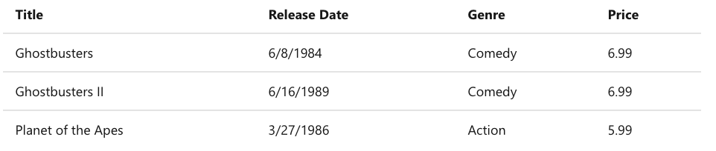
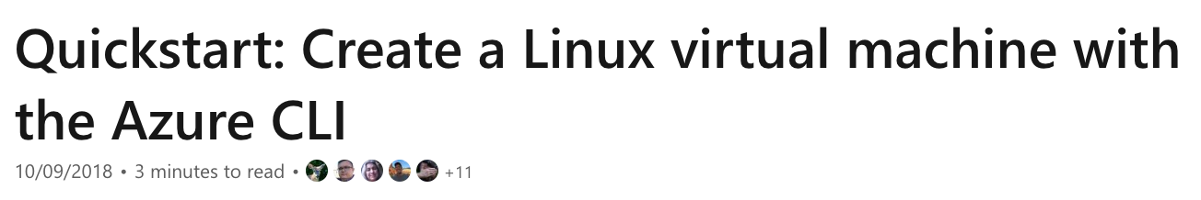
ASP.NET MVC
Markdown & Liquid
Model
---
title:'Quickstart: Use the Azure CLI to create a Linux VM’
ms.date: 10/09/2018
---
# Quickstart: Create a Linux virtual machine with the Azure CLI
public class Movie {
public int ID { get; set; }
public string Title { get; set; }
public DateTime ReleaseDate { get; set; }
public string Genre { get; set; }
public decimal Price { get; set; }
}
Template Logic
<title>{{ page.title }}</title>
@foreach (var item in Model) {
<tr>
<td>@Html.DisplayFor(m => item.Title)</td>
<td>@Html.DisplayFor(m => item.ReleaseDate)</td>
<td>@Html.DisplayFor(m => item.Genre)</td>
<td>@Html.DisplayFor(m => item.Price)</td>
</tr>
}
{%- for i in (0..contributorCount) -%}
<li>
<img data-src=
"{{ contributor.profile_url }}.png?size=32" />
</li>
{%- endfor -%}
{{content}}
Output

Slide 13
ASP.NET MVC
Markdown & Liquid
Model
---
title:'Quickstart: Use the Azure CLI to create a Linux VM’
ms.date: 10/09/2018
---
# Quickstart: Create a Linux virtual machine with the Azure CLI
public class Movie {
public int ID { get; set; }
public string Title { get; set; }
public DateTime ReleaseDate { get; set; }
public string Genre { get; set; }
public decimal Price { get; set; }
}
Template Logic
<title>{{ page.title }}</title>
@foreach (var item in Model) {
<tr>
<td>@Html.DisplayFor(m => item.Title)</td>
<td>@Html.DisplayFor(m => item.ReleaseDate)</td>
<td>@Html.DisplayFor(m => item.Genre)</td>
<td>@Html.DisplayFor(m => item.Price)</td>
</tr>
}
{%- for i in (0..contributorCount) -%}
<li>
<img data-src=
"{{ contributor.profile_url }}.png?size=32" />
</li>
{%- endfor -%}
{{content}}
Output
Runs Every Request
Runs 1x per Build

Slide 14








GitHub and Build
GitHub
Azure Cloud Build
Fork: thedanfernandez/
MicrosoftDocs/azure-docs
MicrosoftDocs/azure-docs
docfx docfx.json
MD
YML
MD
PR
Webhook
Git Clone
DocFx
Apply
Template
Copy to
Blob Storage
URLs map to markdown file paths
Branches:
live: docs.microsoft.com
master: review.docs.microsoft.com
mybranch: ?branch=mybranch

Slide 15







Page Load
URL | Blob
docs.microsoft.com/azure/ | docs.blob.core.windows.net/azure/index.html
URL to Blob
Cache?
No
.NET Web App
Blob Storage
docs.microsoft.com/azure/
Yes
Akamai CDN
App Insights
Cloud Build

Slide 16

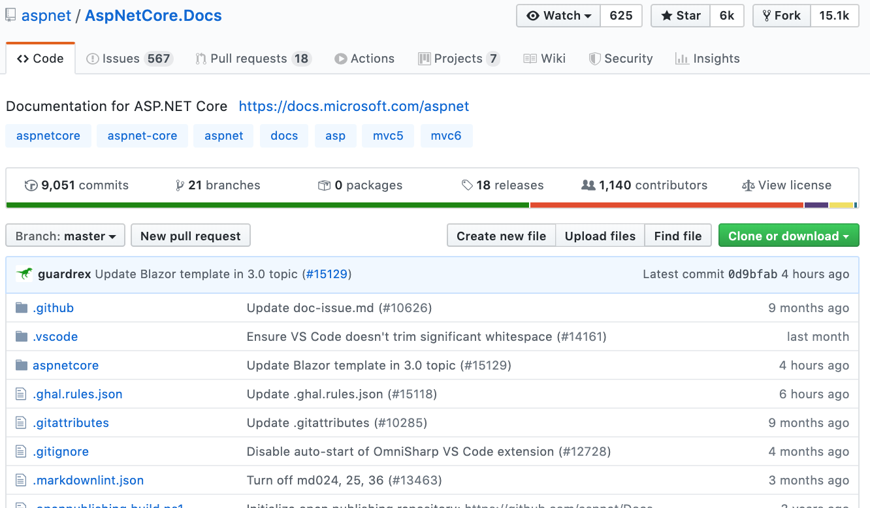
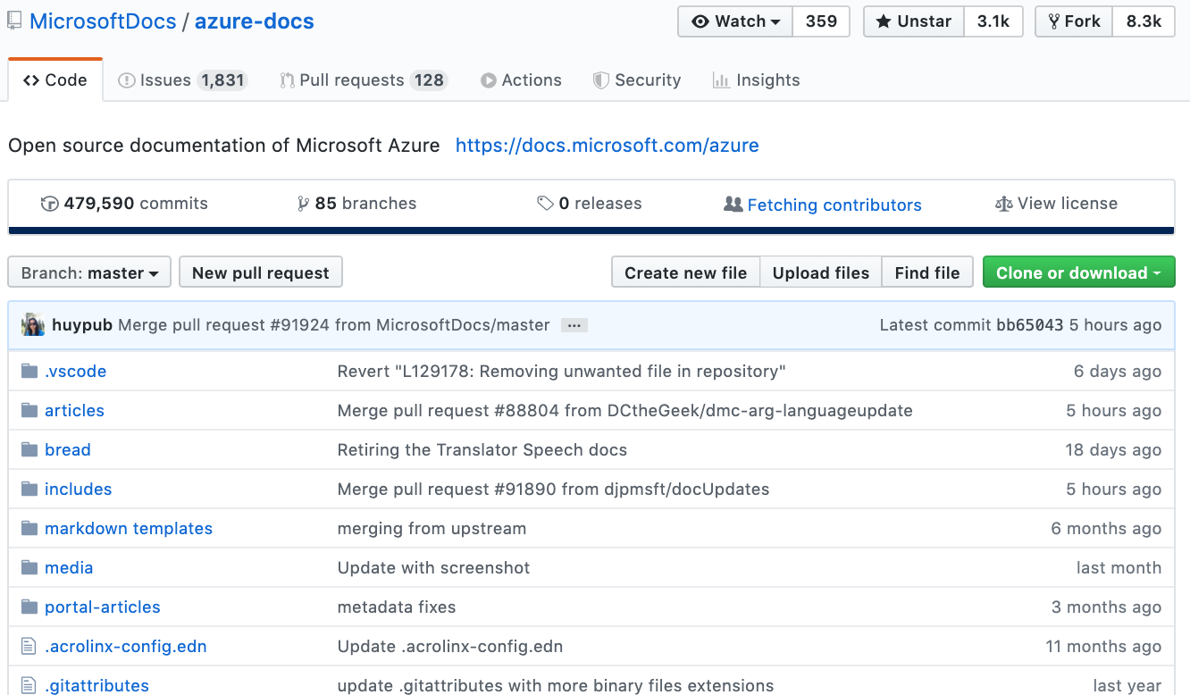
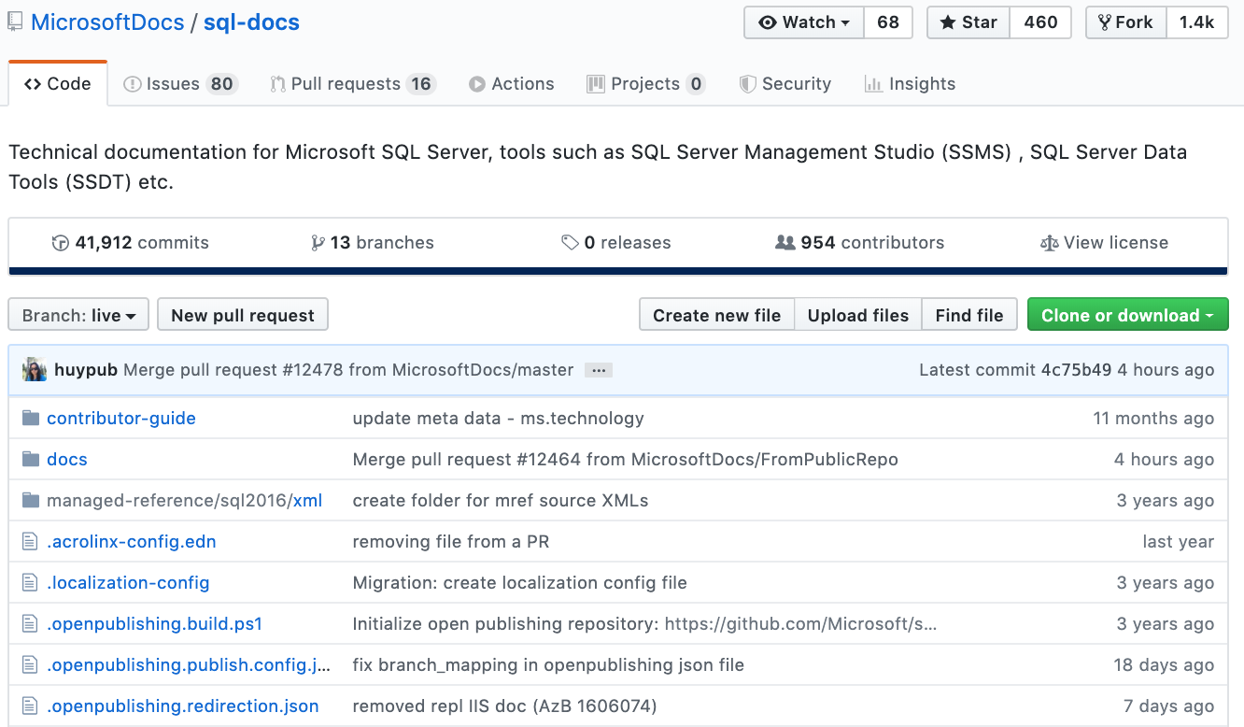
Docs combines hundreds of independent GitHub repos Scale out: Independent repos, storage, and build
docs.microsoft.com/
/aspnet/core/
/azure/
/sql/
...
aspnet/AspNetCore.Docs/
MicrosoftDocs/azure-docs/
MicrosoftDocs/sql-docs/
Private Repos
MicrosoftDocs/azure-docs-pr/
MicrosoftDocs/sql-docs-pr/

Slide 17
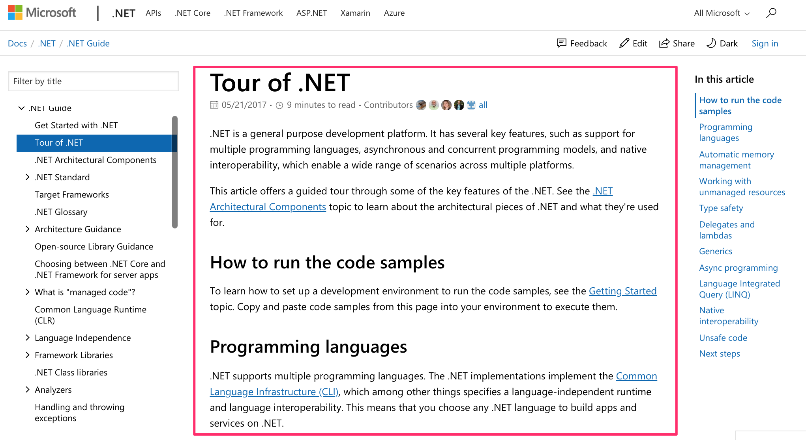
From Fully Static to Static + Dynamic Site Chrome
Duplicate site chrome (header/footer, left/right nav, css) for every content build.
Before: Static
Each site created full HTML page content
After: Dynamic Chrome / Styles
Decoupled site chrome from content
Content Build only creates red section

Slide 18
GitHub

Slide 19
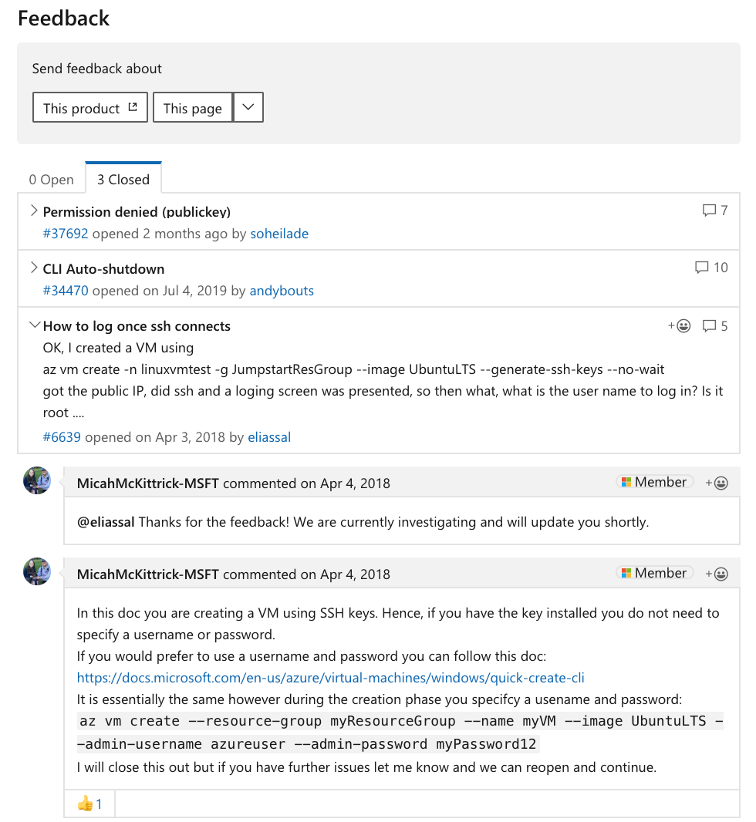
From “Black Hole” to Comments to GitHub Issues
“…with sites like MSDN, there’s no way to tell anyone, it’s a black hole of feedback and I’m not even going to bother to do it”
Comments
Product / Content Feedback intermingled
No State: Open, In-Progress, Closed
No categorization
Can’t assign to users
GitHub Issues
Product vs Content Feedback
Discuss specific issue
Track State: Open, In-Progress, Duplicates
Assign Users
Labels: AI to auto-set
Virtuous Cycle: Notification when your issue is fixed
https://utteranc.es/

Slide 20
DevOps
Deployments
CI/CD Pipeline using Azure DevOps
Pipeline: Local > Dev > Staging > Production
Web App Slots
UX Automation for browser testing / validation
Independent Deployments
UX Templates: Daily / On-Demand
Build (DocFx) 1x every 3 weeks
Services: Independently and On-Demand

Slide 21
GitHub and Community
Checklist
Setup
Contributor License Agreement
Repo License
Microsoft Open Source Code of Conduct
Issue templates and Labels “Up for Grabs”
Contributor Guide
GitHub Projects: Kanban for all docs (ASP.NET Docs)
Docs Feedback: Open a GitHub issue directly from Docs
Pull Request: CI to add any content validation, quality, linters, etc
Recognize Contributors: List in each article

Slide 22


Localized Community Contributions
65+ Languages
Pull Requests cascade to fix all languages
Click Edit
Fork on GitHub
Submit PR
Live on LOC Site
( magic happens )
Live on all sites

Slide 23
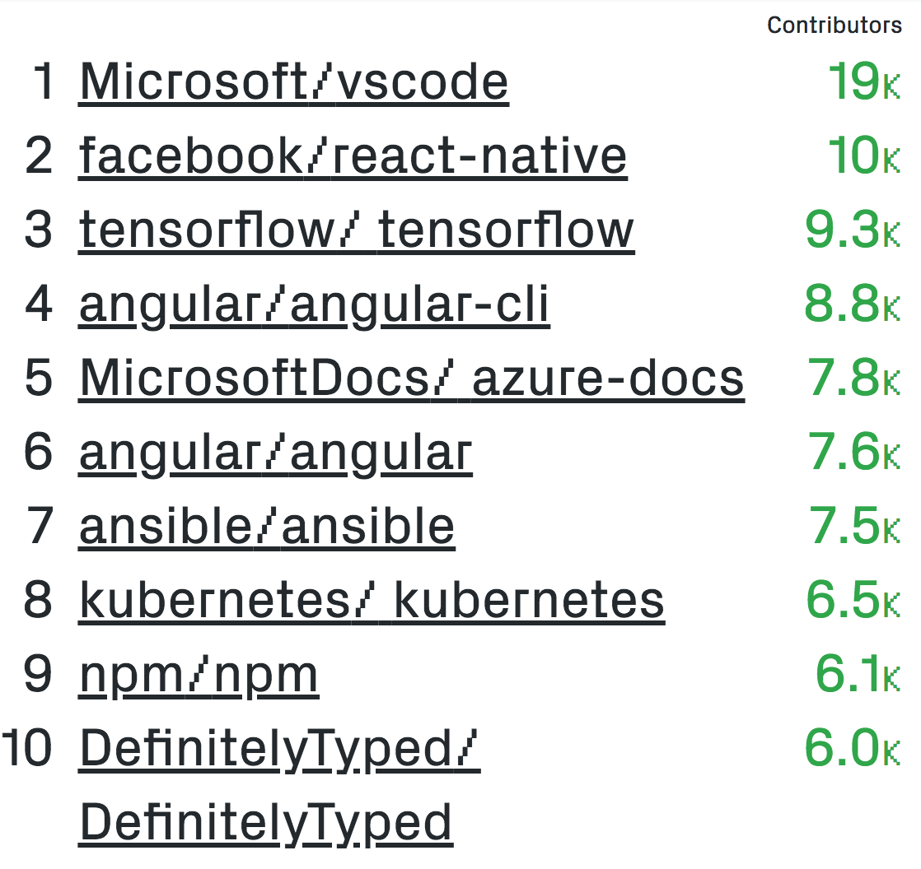
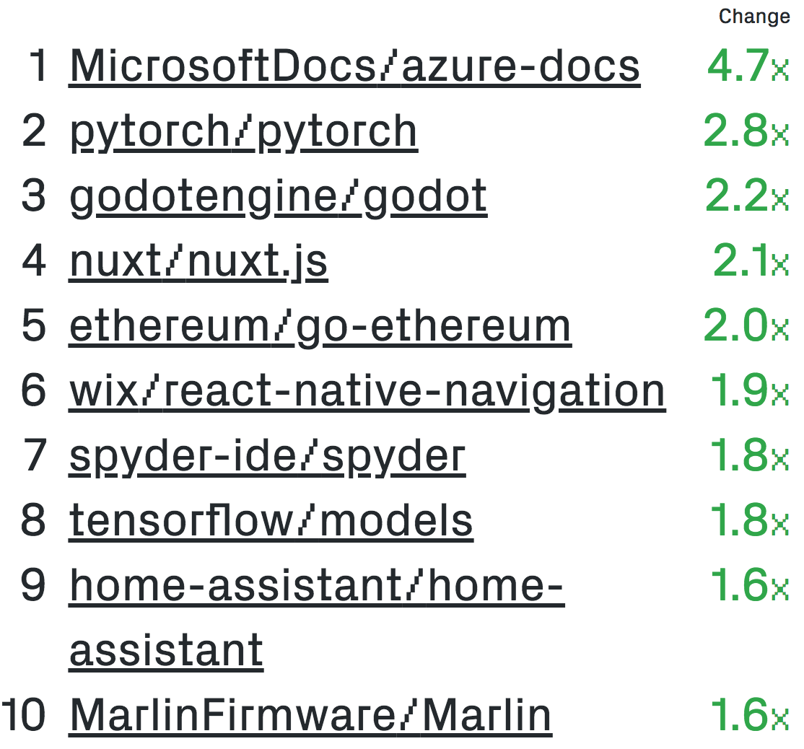
Microsoft GitHub
2k+ Public Docs Repositories
Top Projects
Fastest Growing

Slide 24
API Reference

Slide 25
API Reference
Automate Manual Release Process: Code release to updated docs in minutes
Programming Language Support: Provider for each language, Cross-language JSON Schema: (names, inputs, types, return values, internal references)
Add Versioning: “A lot of the content in MSDN was written 3 versions ago and it references incompatible technology”
Examples First: Reference examples are way more helpful and no one reads the verbiage. If you have a method, show code snippets for it”
Current Scale:
90K+ API CI Jobs in 9 months
~15M+ Docs
Cs
C#
Ps
PowerShell
Jv
Java
Qs
Quantum
Az
Azure CLI
Py
Python
Sw
Swagger
Ts
TypeScript
Js
JavaScript

Slide 26
GitHub -> New Package ->Azure DevOps-> Docs
npm Package or Source Code
JSDoc/
TypeDoc
Schema Document Processor
PyPI Package, sdist/bdist or Source Code
Sphinx
Schema Document Processor
Maven Package or Source Code
Javadoc
Schema Document Processor
Swagger Spec
NuGet Package or DLLs
Swagger Processor
mdoc
Schema Document Processor
Schema Document Processor
YAML + Markdown
YAML + Markdown
YAML + Markdown
YAML + Markdown
YAML + Markdown
docs.microsoft.com
docs.microsoft.com
docs.microsoft.com
docs.microsoft.com
docs.microsoft.com

Slide 27
API Browser Microservice
One place to search, by language, every Microsoft API ever
“It would be super cool if API search was just like IntelliSense.”
.NET / Java / Python / TypeScript/JavaScript
REST/Swagger + Auth
URL is the fully qualified type
“Every time I am searching, everyone assumes I am using the latest version. Good to see that I can change the version because I work with legacy code.”
Versioning Support
Don’t burn version in URL ?view={version}
Default to latest
Easily filter by version
Crawler
Search Indexer
Azure Search
Cosmos DB
REST API
Docs

Slide 28
Demo API Reference docs.microsoft.com/dotnet/api docs.microsoft.com/rest/api

Slide 29
Learn

Slide 30
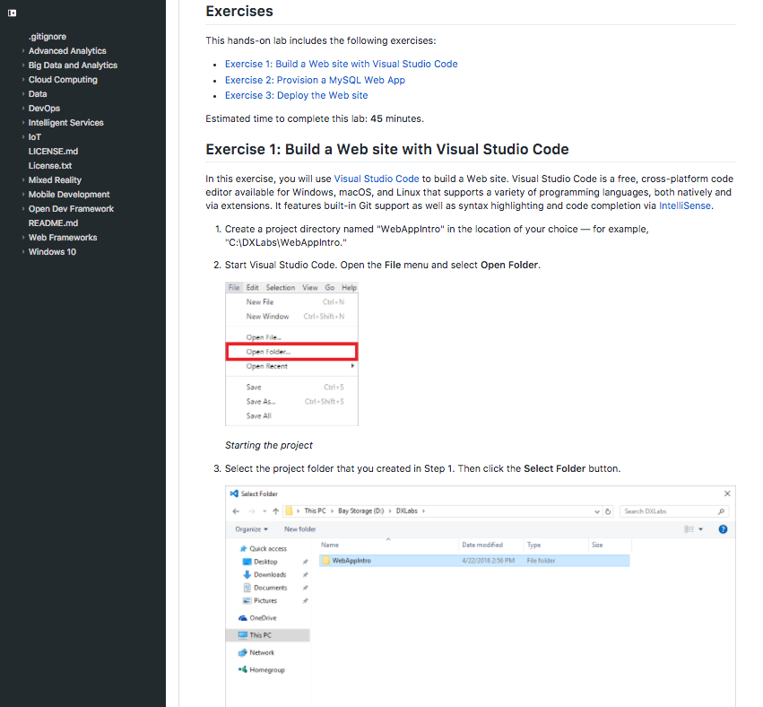
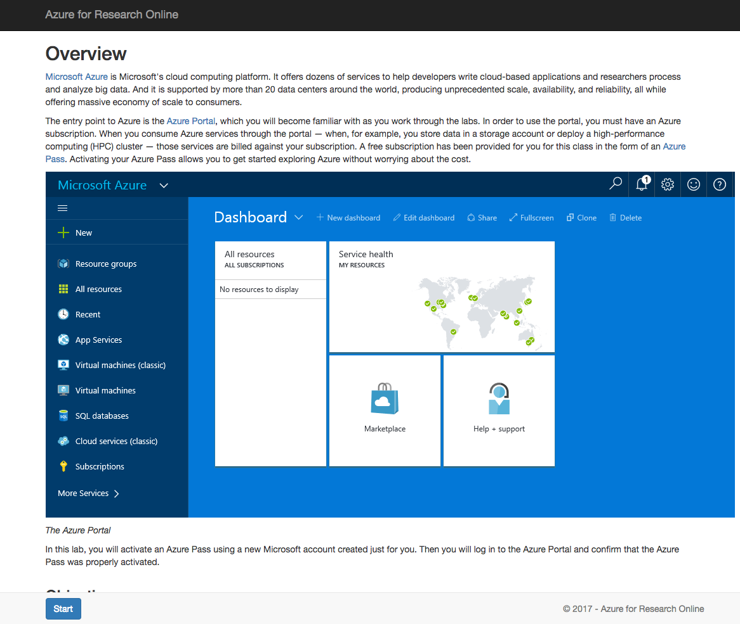
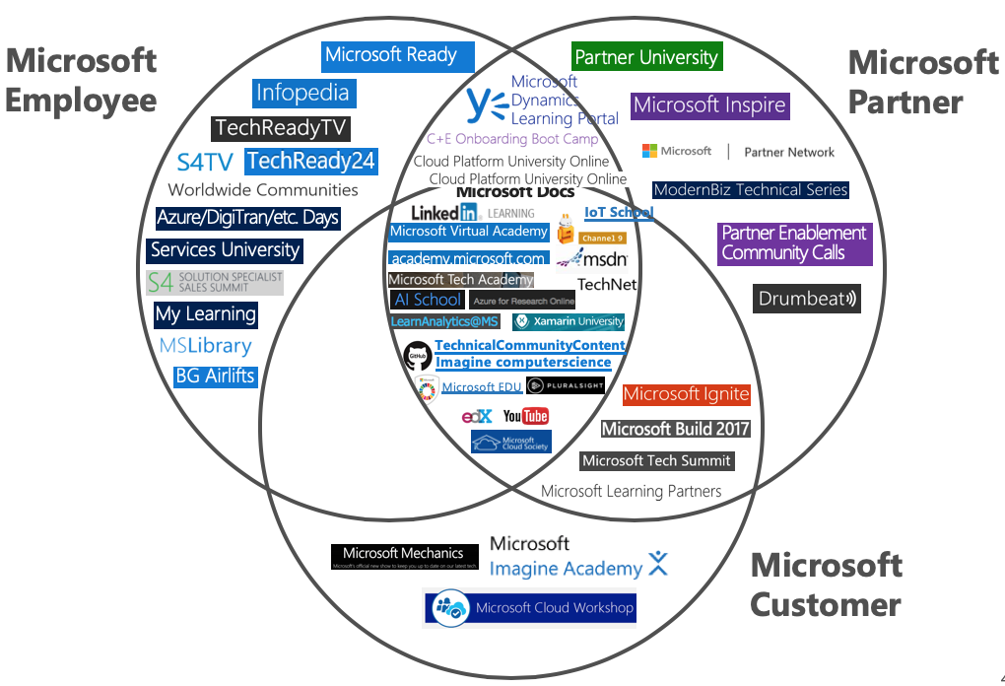
Learning at Microsoft
Incorrect/Inconsistent
Out-of-Date
Duplication

Slide 31
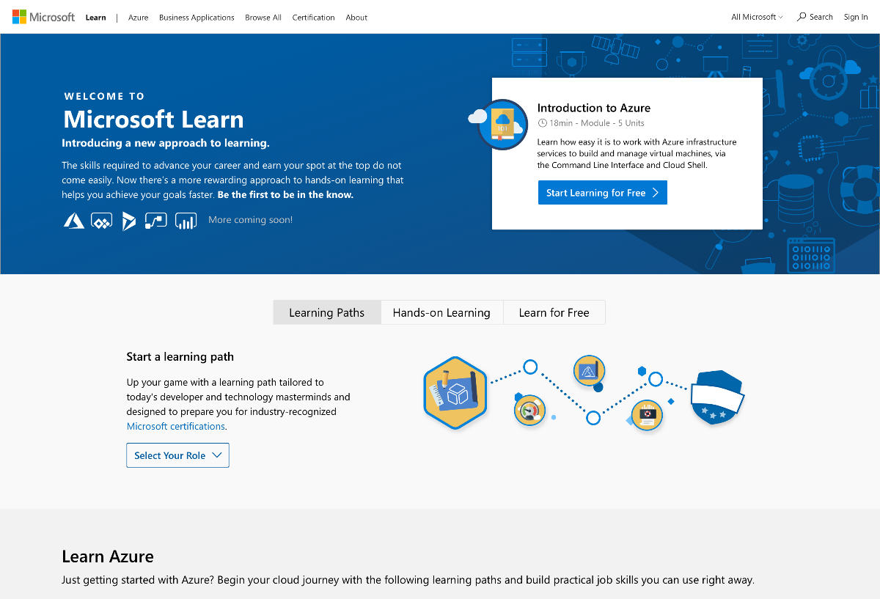
A New Approach to Learning
Learn By Doing
Step-by-Step Learning & Progress Tracking
Consistent Learning Structure
Friction Free Sandbox – No credit card required
Points, Achievements, and Levels
Not a ”Learning Dumping Ground” – Must follow Learn content model

Slide 32
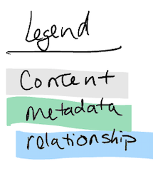
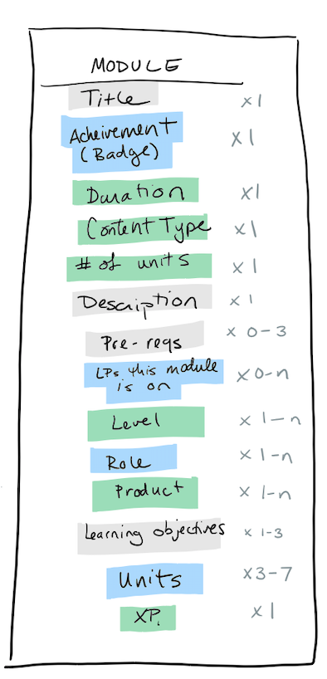
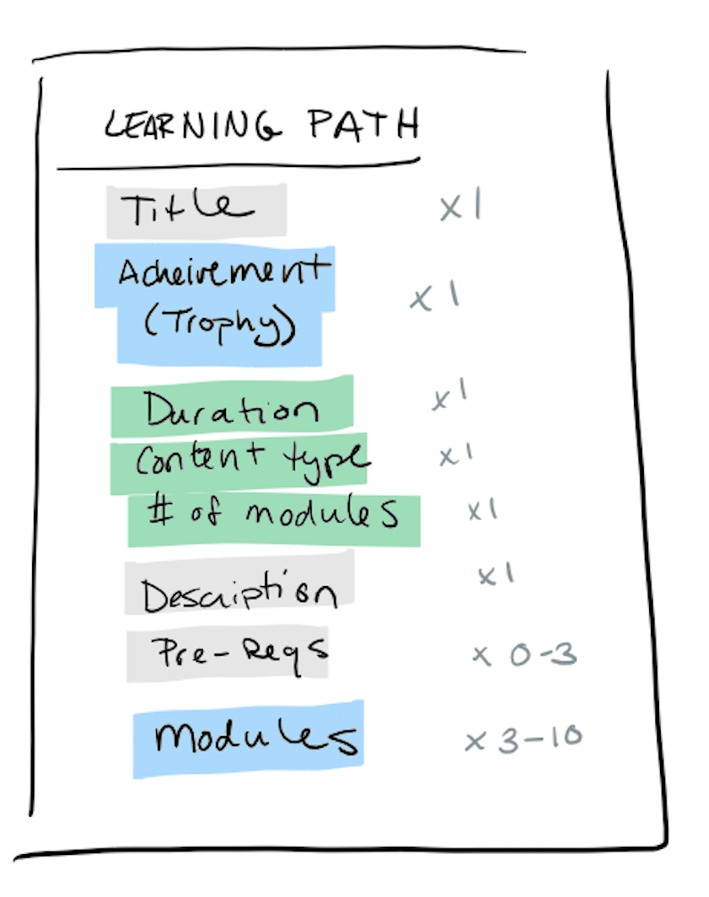
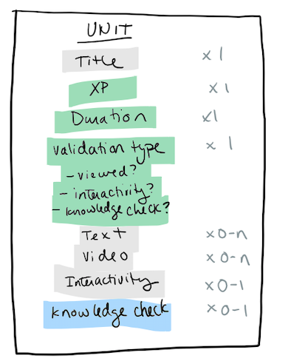
Learn Content Model

Slide 33
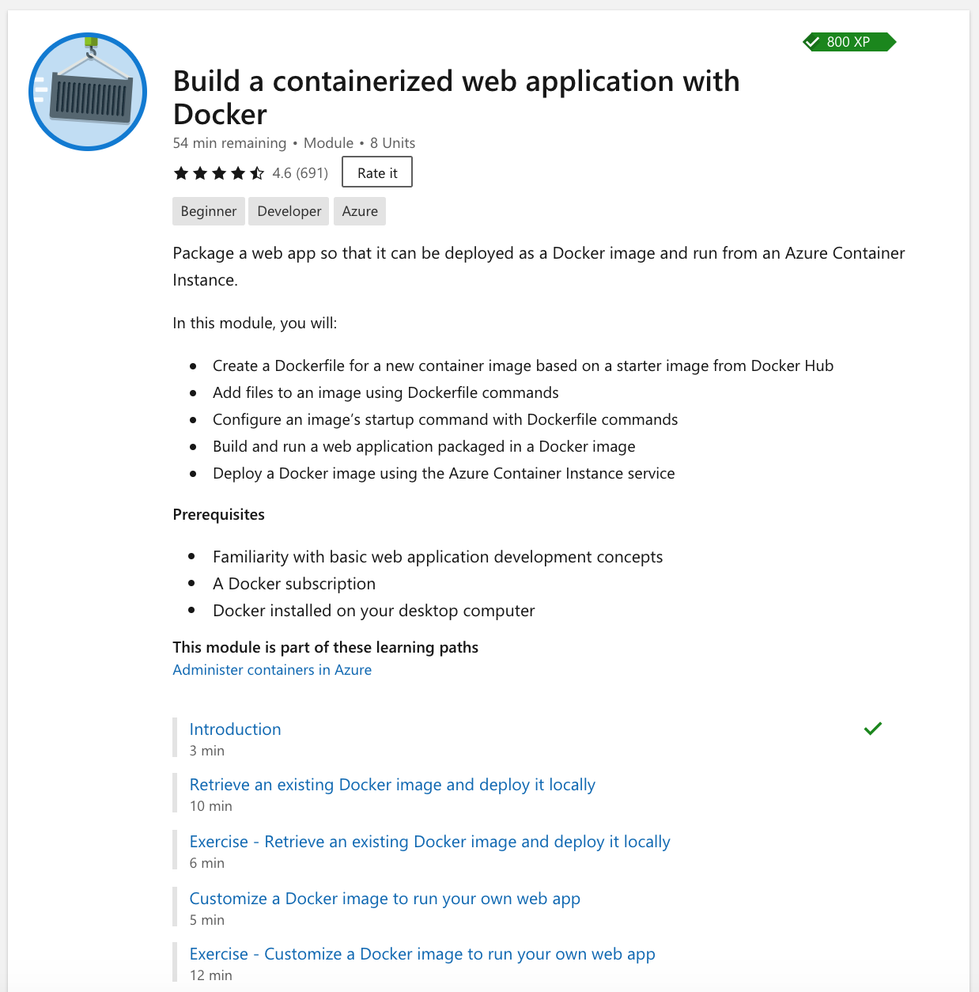
Learn: YAML Data Model
### YamlMime:Module
uid: learn.intro-to-containers
metadata:
title: Build a containerized web application with Docker
description: In this module, you'll learn how to use Docker to quickly deploy a web application.
ms.date: 04/05/2019
title: Build a containerized web application with Docker
summary: Package a web app so that it can be deployed as a Docker
image and run from an Azure Container Instance.
abstract: |
In this module, you will:
- Create a Dockerfile for a new container image based on a starter
image from Docker Hub
prerequisites: |
- Familiarity with basic web application development concepts
iconUrl: /learn/achievements/intro-to-containers.svg
levels:
- beginner
roles:
- developer
products:
- azure
units:
- learn.intro-to-containers.1-introduction
- learn.intro-to-containers.2-deploy-docker-image-locally
- learn.intro-to-containers.3-exercise-deploy-docker-image-locally
- learn.intro-to-containers.4-create-custom-docker-image
- learn.intro-to-containers.5-exercise-create-custom-docker-image

Slide 34
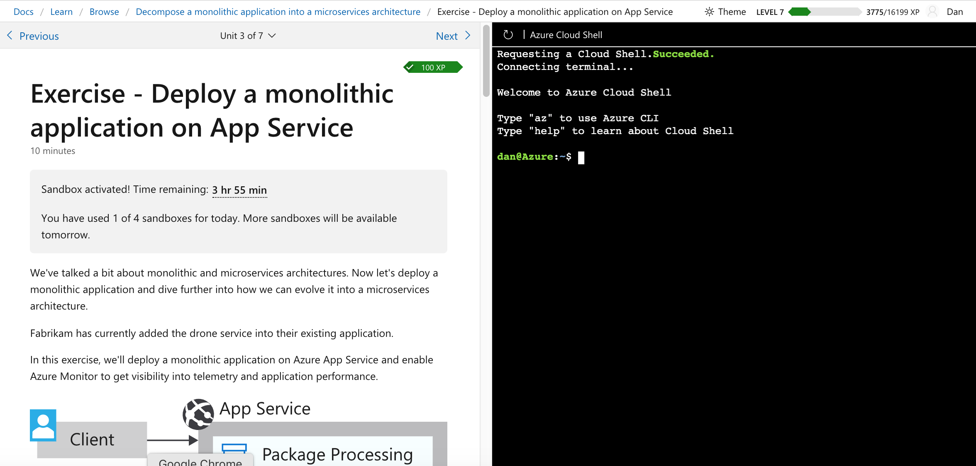
Learn: Static content, Dynamic microservices
Progress
Microservice
Profile Microservice Name, XP, Level, Profile link
Hierarchy
Microservice
Sandbox
Microservice
Static HTML from Metadata and Markdown
Azure Cloud Shell

Slide 35
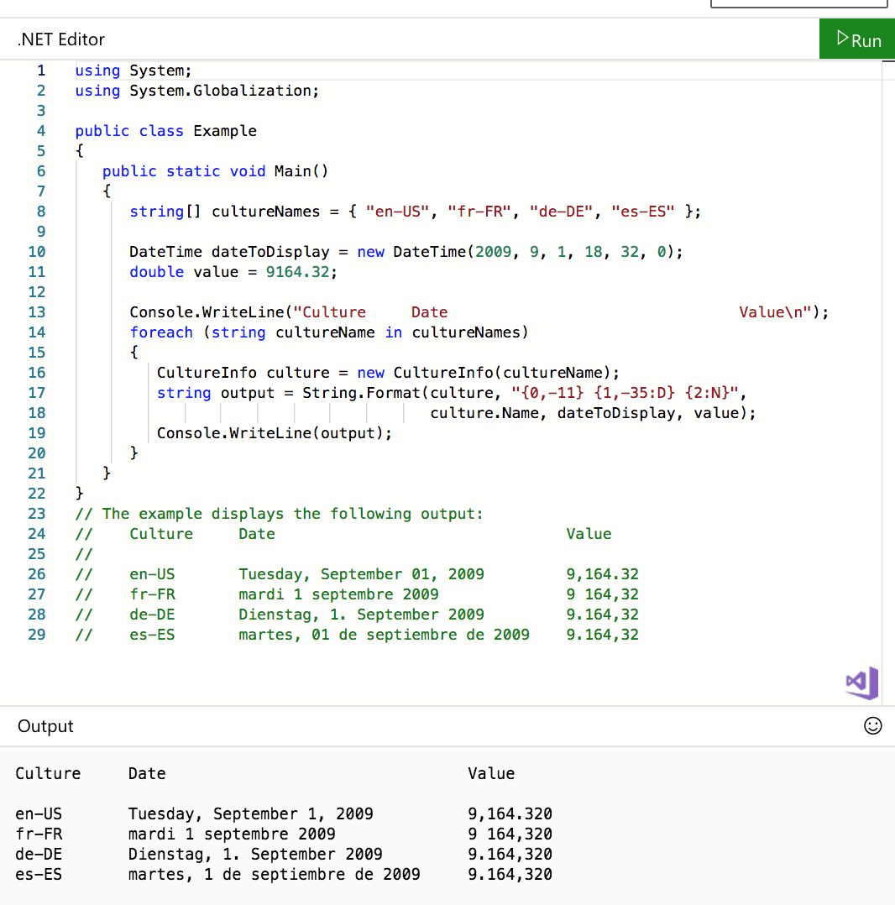
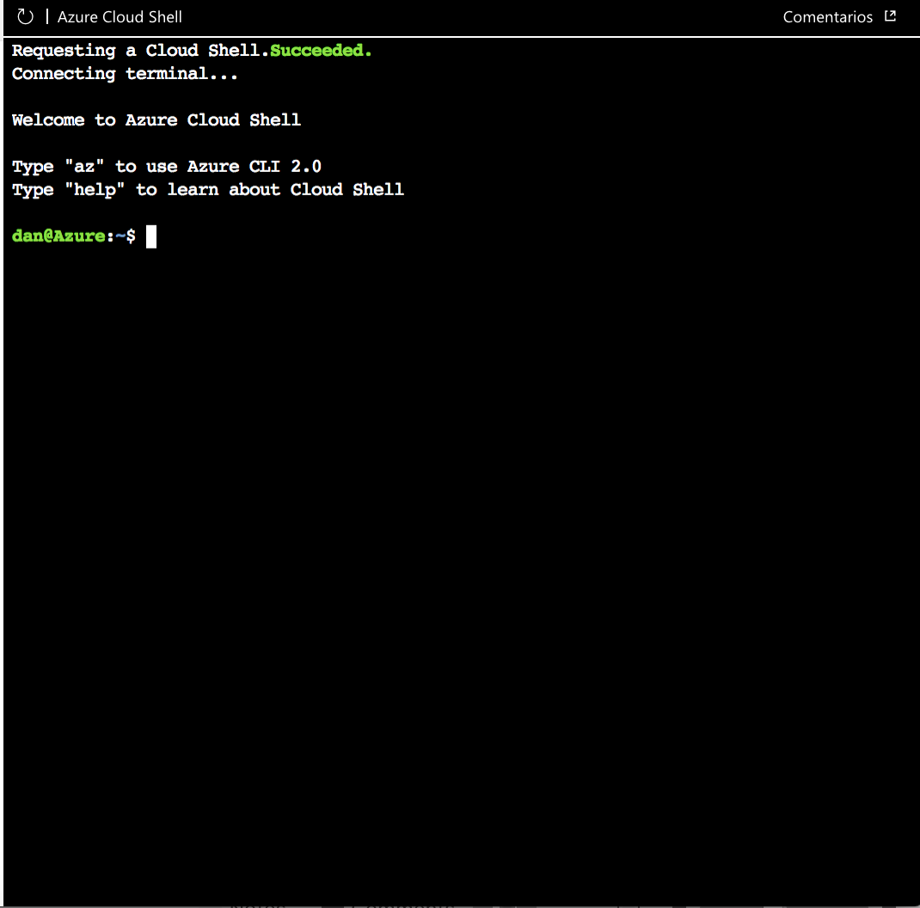
Containers for Websites
Stateless: Try.NET
Each request uses a different container
Good for small changes
Less total containers, better scale
Stateful: Azure Cloud Shell
Each customer gets a dedicated Cloud Shell and Storage
Good for administrative commands and full products
Personal private storage

Slide 36
Learn Demo

Slide 37
Lessons Learned
JAMStack is revolutionary
Results focus: What is the outcome you are driving? Add Analytics
Learning curve for Git, GitHub, and Markdown don’t dismiss this
Prefer Implicit versus explicit: Pool Party AI infers metadata
Evaluate images/media in your repo: Azure SDK 6GB versus 50MB of content
Feedback and community requires time and effort
CI / Automation Errors vs Warnings: Balance between blocking everyone and being ignored
Use NuGet/DLLs versus source code for .NET libraries
“Good Enough” versus “Gold Plating” Ex: Time to read calculation
Consider potential for misuse: Design guardrails and/or validation (remove JS/CSS)
Content lifecycle: Latest, versions, archive (no-index / no-follow), retire,
Sweat the Details
Organizing types in the left TOC
Fast performance is delightful
Interactive coding
IntelliSense in the browser
Fundamentals:
Inclusive Design
Localization and Globalization
Docs and Learn are a
Team Sport
Treat Documentation like an OSS Project: Git, GitHub, CI, GitHub Issues, Community Contributions, Twitter, Advocate for customers

Slide 38
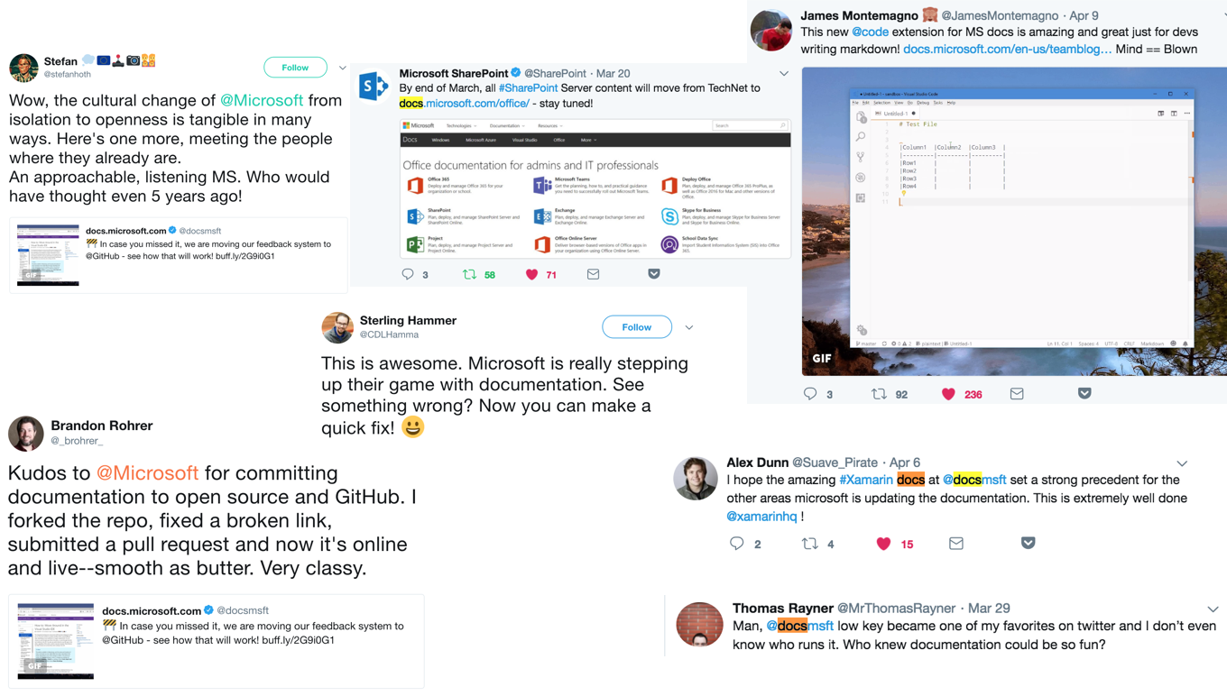
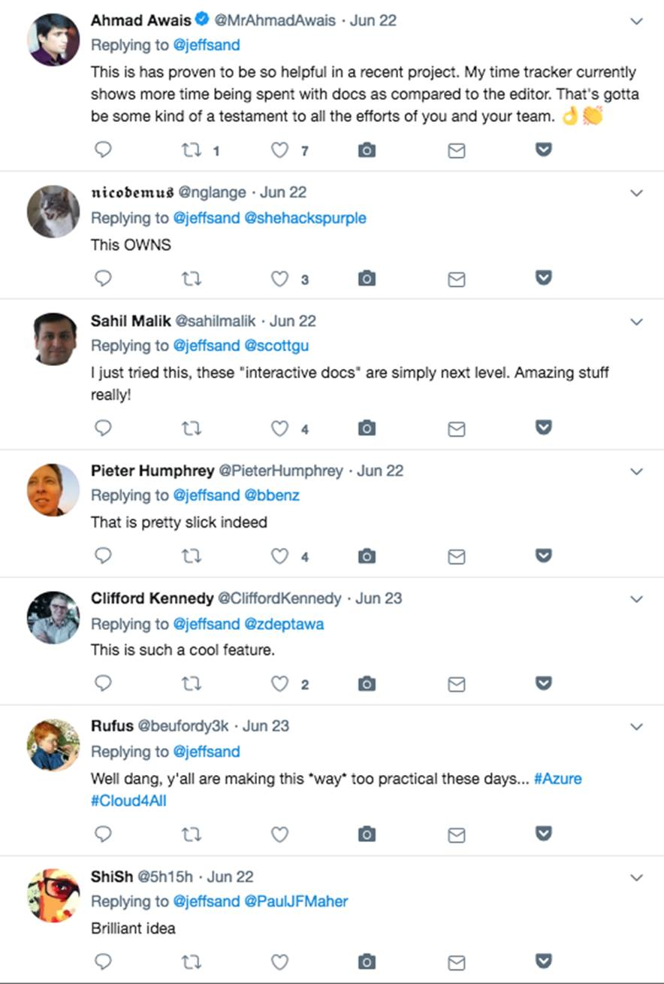
Experiences customers love

Slide 39
Resources
Static Site Generators
JAMStack Homepage
Static Gen – All Static Sites
Jekyll Ruby / Liquid
Hugo Go / Go Templates
GatsbyJS Node / GraphQL
DocFx ASP.NET / Liquid
RazorLight ASP.NET / Razor
Eleventy 11 template languages
Twitter: @danielfe, @docsmsft
Team Blog: https://docs.Microsoft.com/teamblog/
Docs: https://docs.microsoft.com
Learn: https://docs.microsoft.com/learn
Reference: Doctainers
.NET Reference: mdoc
Authoring: Docs Authoring Pack
Add GitHub Issues: https://utteranc.es/
Syntax Highlighter: Highlight.js
Architecture: Azure Architecture Center
Inclusive Design: https://www.microsoft.com/design/inclusive/
Content CMS: NetlifyCMS, Contentful, Strapi.io

Slide 40
Thank you!

Slide 41
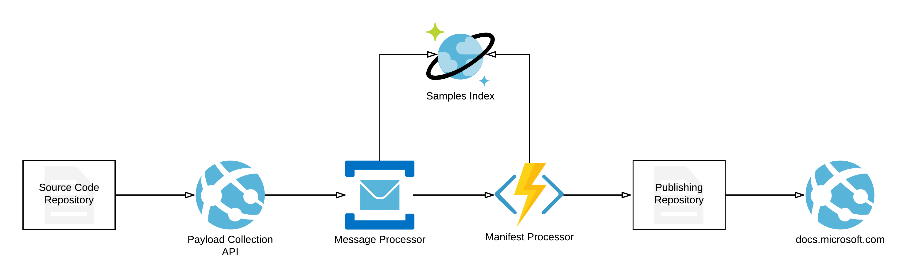
Samples
https://den.dev/blog/building-microsoft-samples/
1,950 samples onboarded to the experience.
Powered by GitHub – ingests README files with specific metadata.
Ingestion works through a webhook, that triggers Azure Pipelines jobs that:
Create a ZIP file with sample contents.
Generate structured YAML metadata in a separate file that is used for docs publishing.
Every sample page works the same as a documentation page.
Integrates the ability to deploy a sample directly to Azure (if ARM template is declared).
Allows authors to have many README files in one repo, which means many samples in the docs.microsoft.com/samples experience from one GitHub origin.
Allows easy testing of samples against a set of governance and quality guidelines.

